Slide 1
GRN of PC differentiation in GC
Ag
CD40L
BcR
CD40
BCL6
IRF4
Parameters increased when constitutive activation of IRF4
BLIMP1
B-cell
MR Martinez, 2012

Slide 2
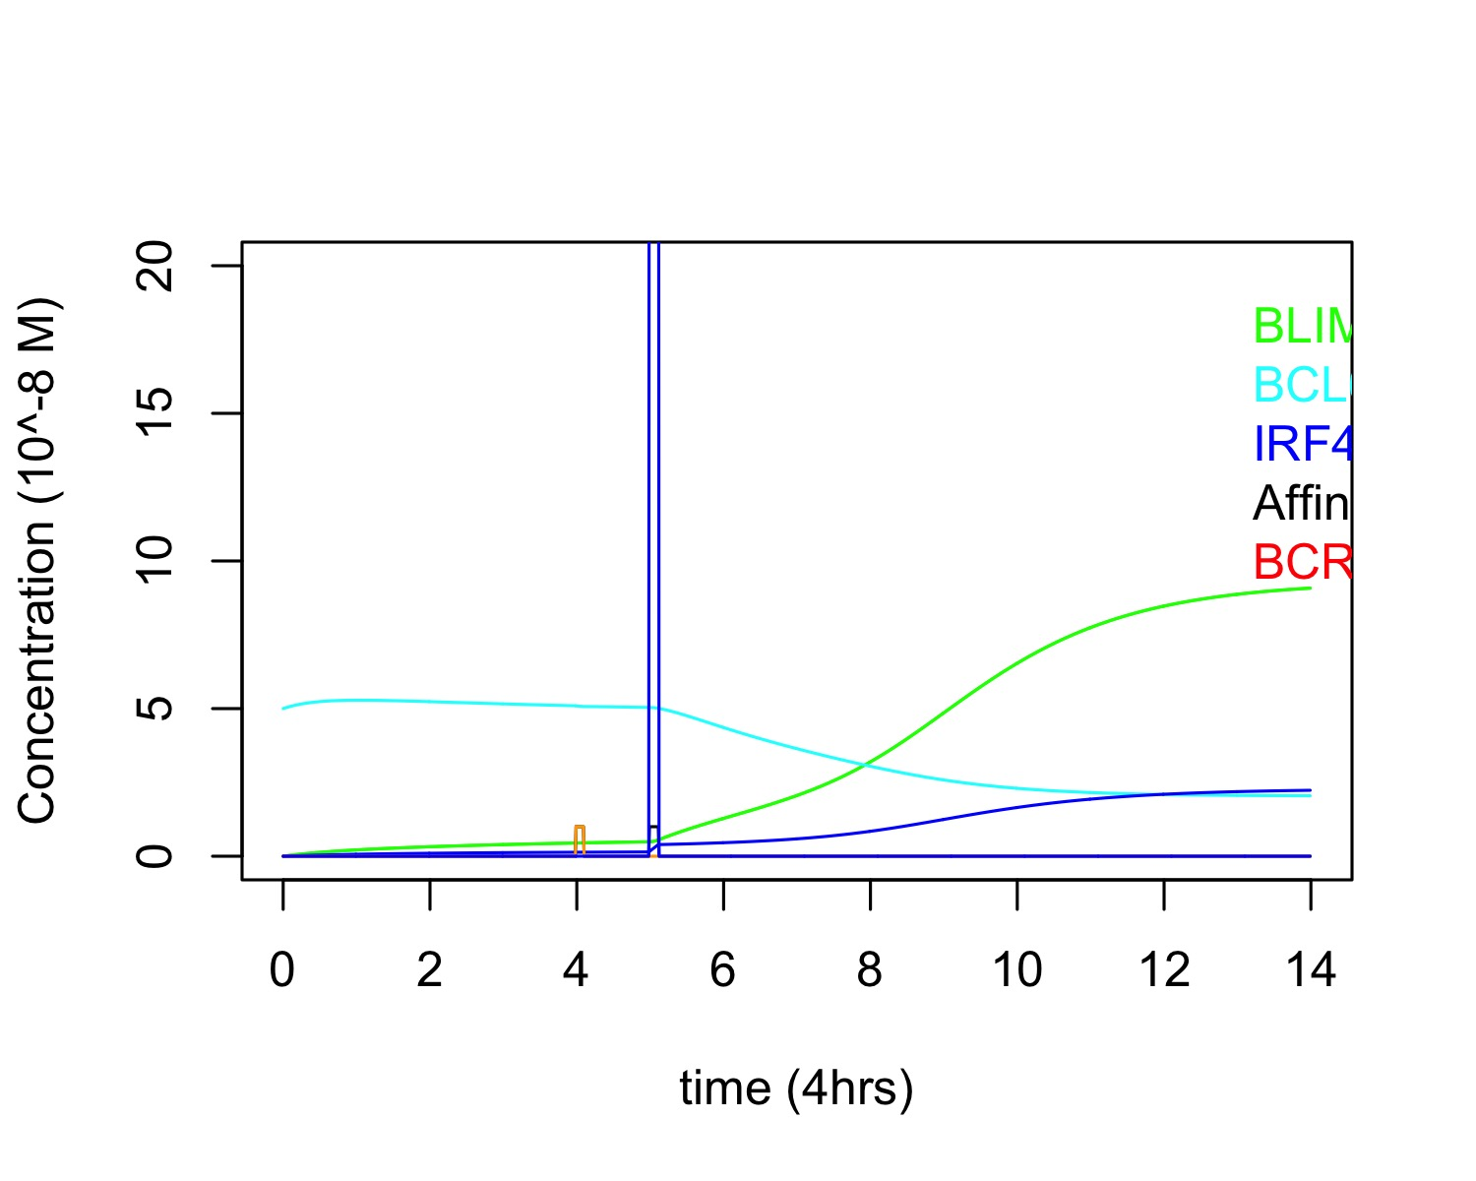
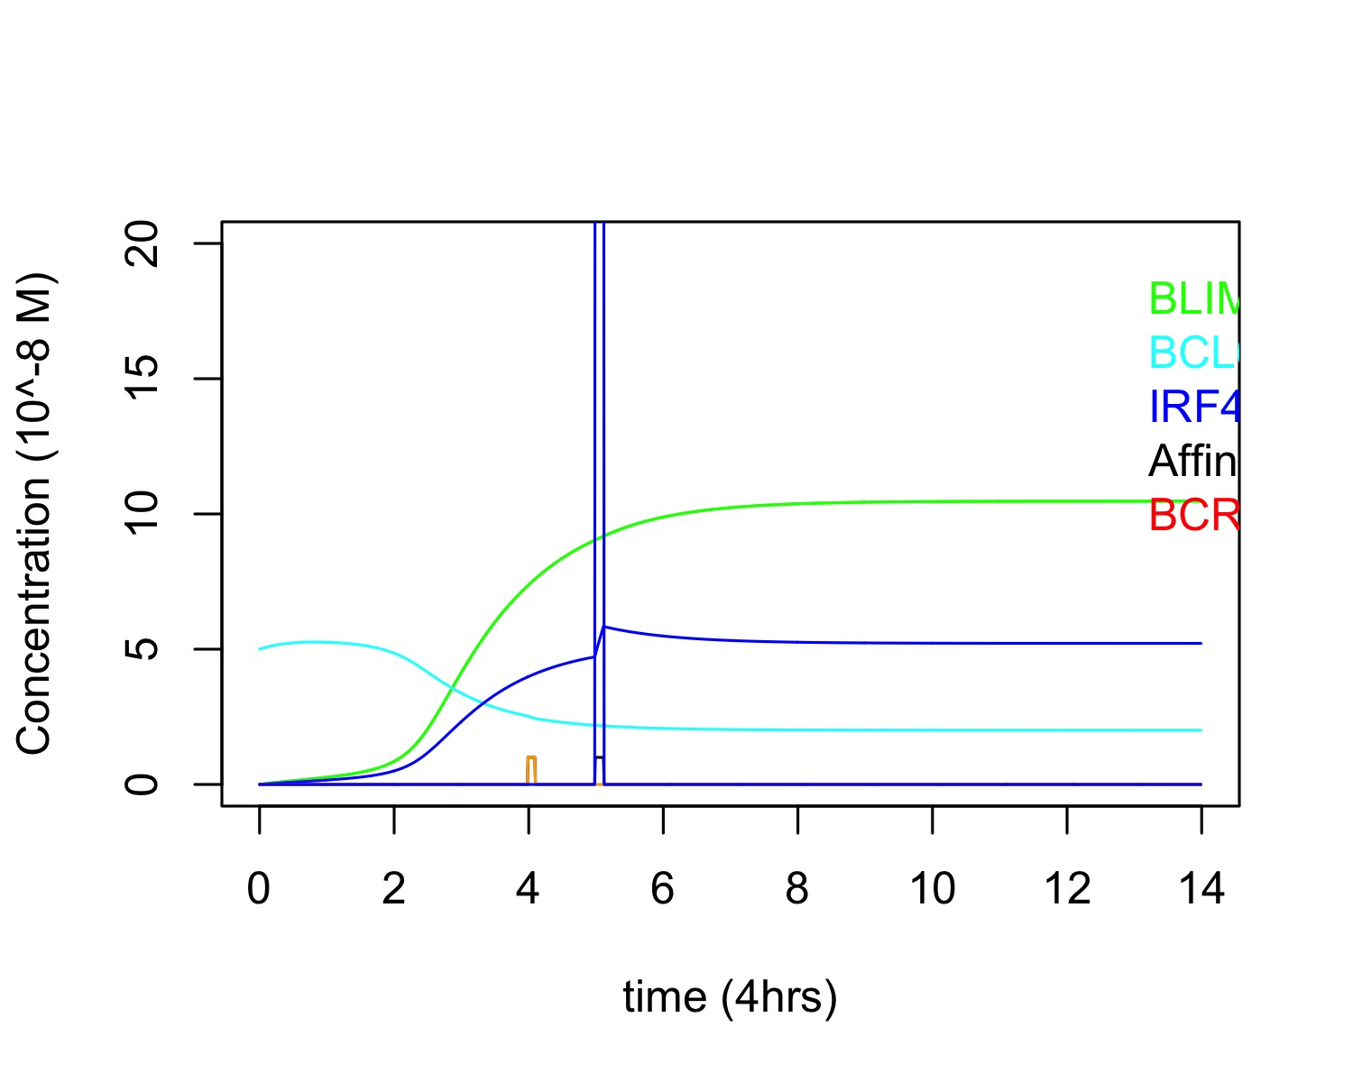
GRN of PC differentiation in GC (Healthy vs M8: Constitutive activation IRF4 )
Healthy
A=1
bcr0=1
bcr0 duration= 0.1 time steps
Cd40=50
Cd40 duration= 0.125 time steps
M8
A=1
bcr0=1
bcr0 duration= 0.1 time steps
Cd40=50
Cd40 duration= 0.125 time steps

Slide 3
GRN of PC differentiation in GC (+Foxo and c-Myc)
Ag
CD40L
Added relations based on luo, 2018
BcR
CD40
FOXO
BCL6
IRF4
cMYC
BLIMP1
B-cell

Slide 4
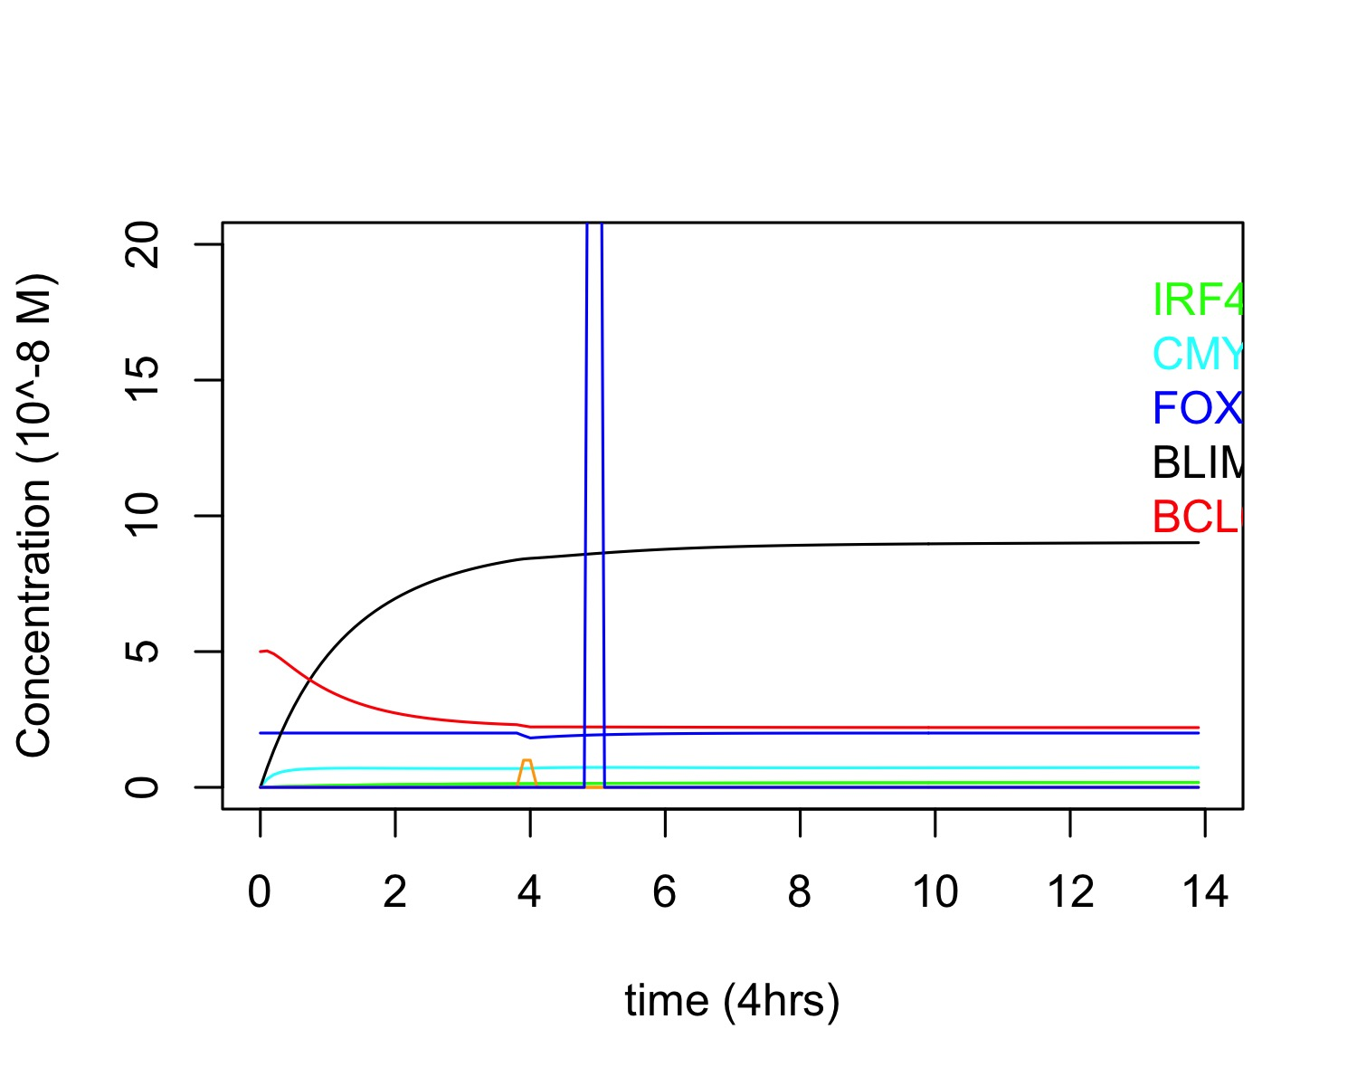
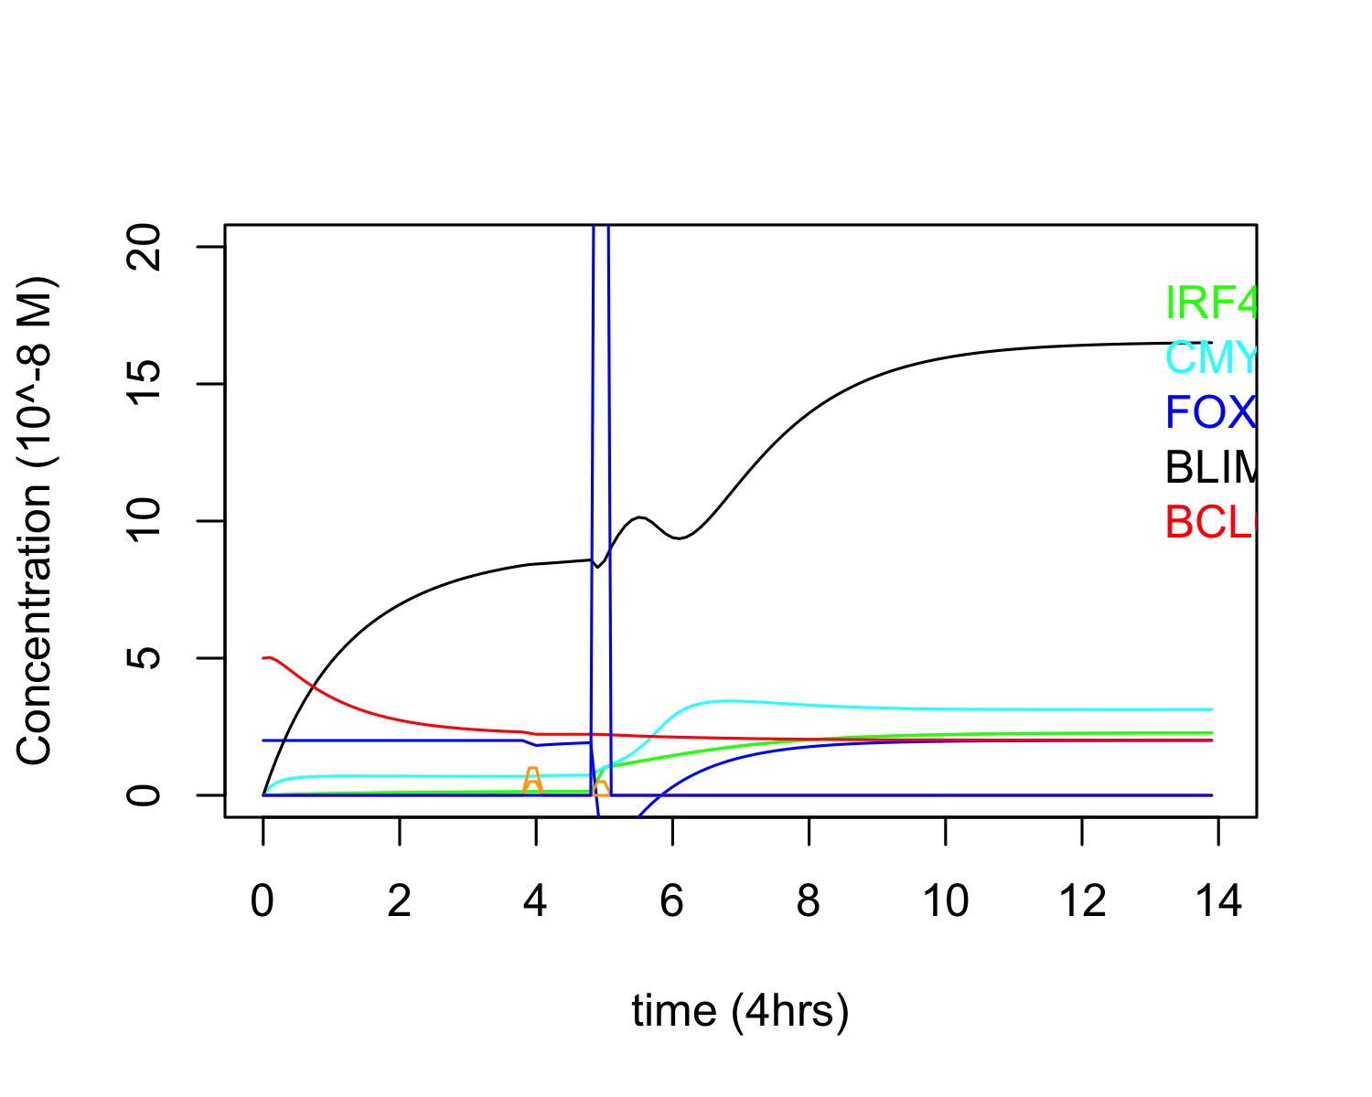
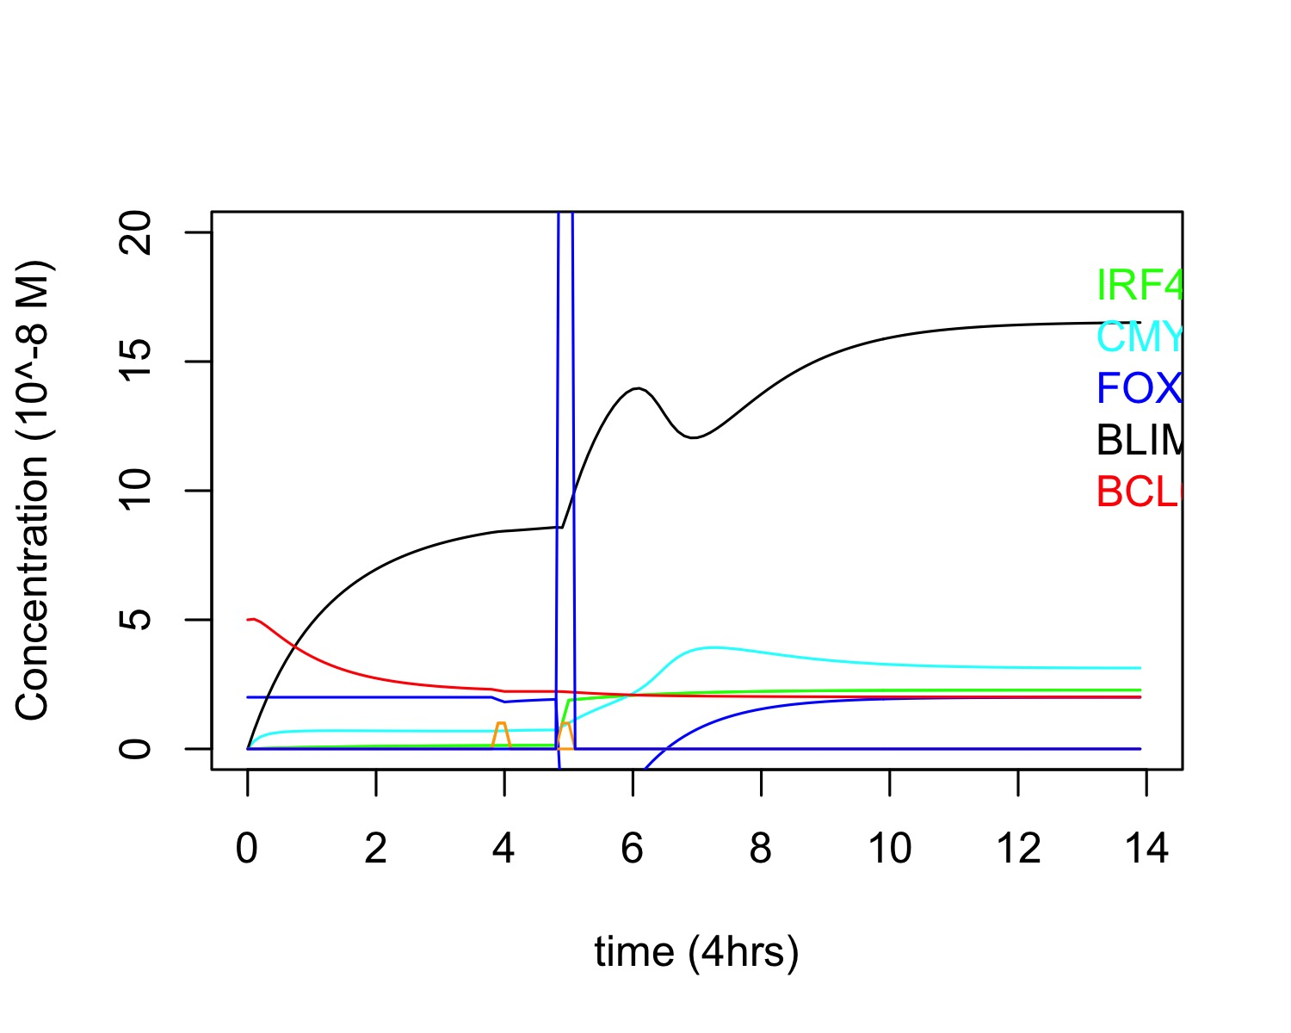
GRN of PC differentiation in GC (Healthy with cMYC and Foxo)
CCs recycling calculate their divisions soon after rescue. Then they wait for 10 hrs before turning to CBs.
PC differentiation can take between 10 and 34 hours (recycling + divisions)
A=0
bcr0=1
bcr0 duration= 0.1 time steps
Cd40=50
Cd40 duration= 0.125 time steps
A=0.5
bcr0=1
bcr0 duration= 0.1 time steps
Cd40=50
Cd40 duration= 0.125 time steps
A=1
bcr0=1
bcr0 duration= 0.1 time steps
Cd40=50
Cd40 duration= 0.125 time steps

Slide 5
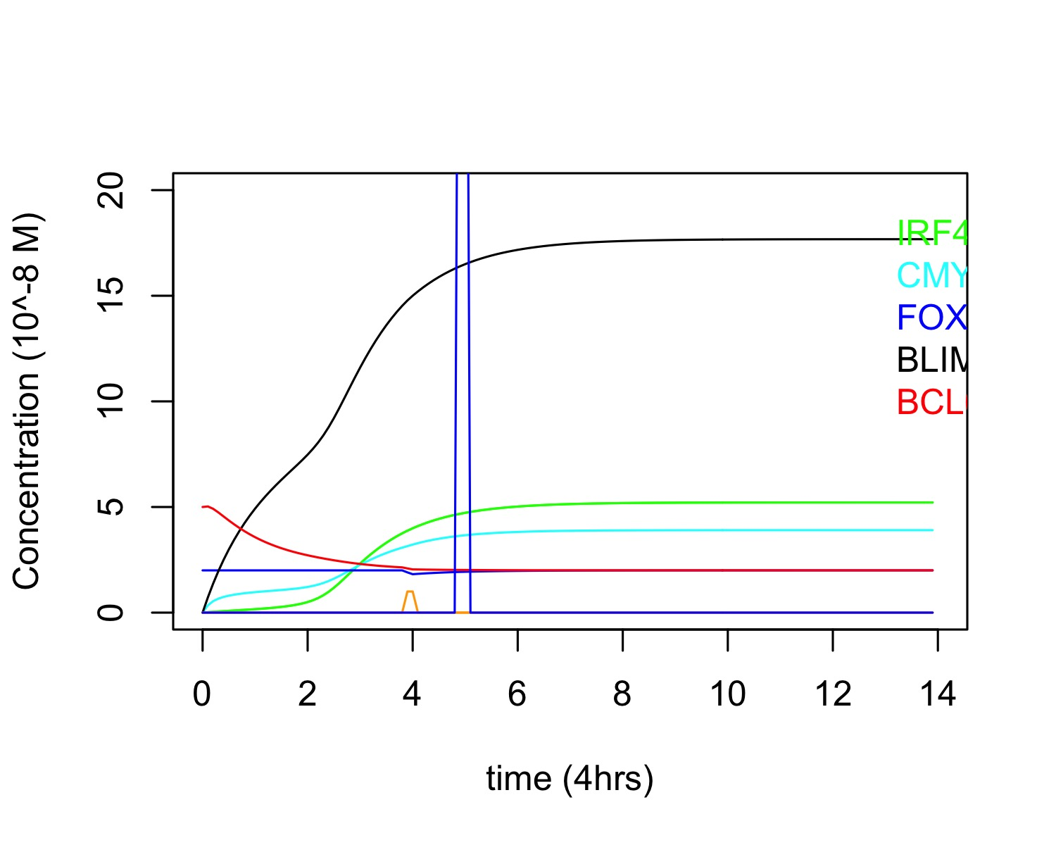
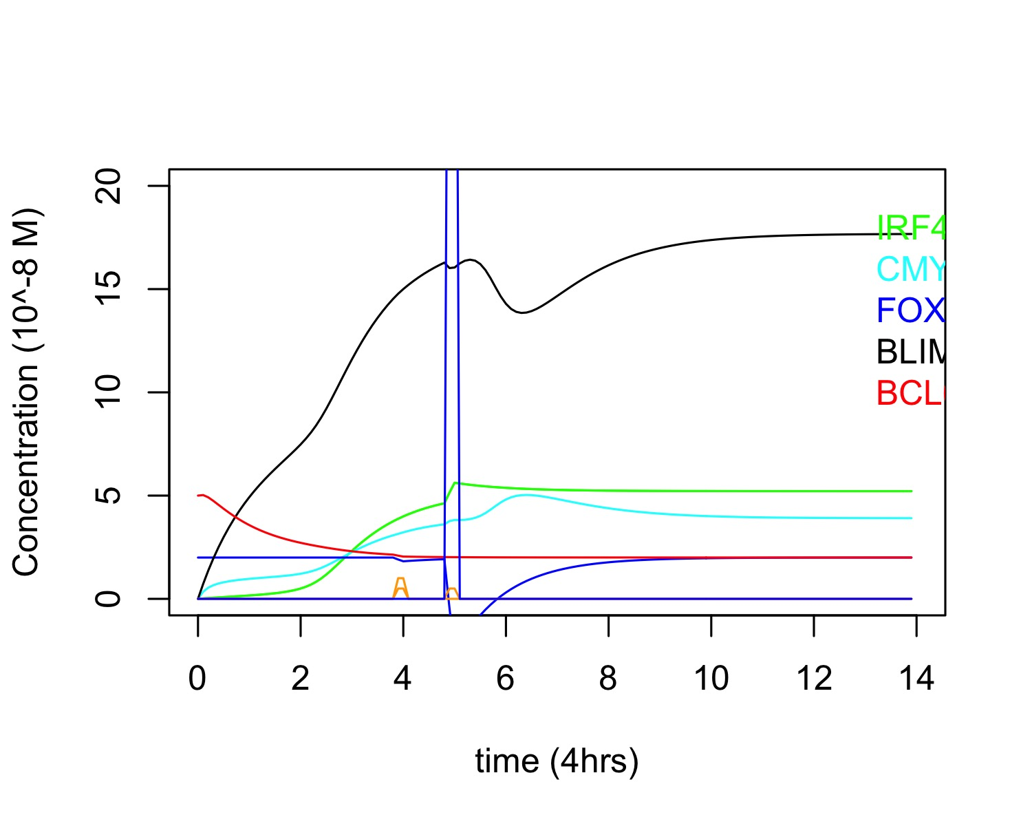
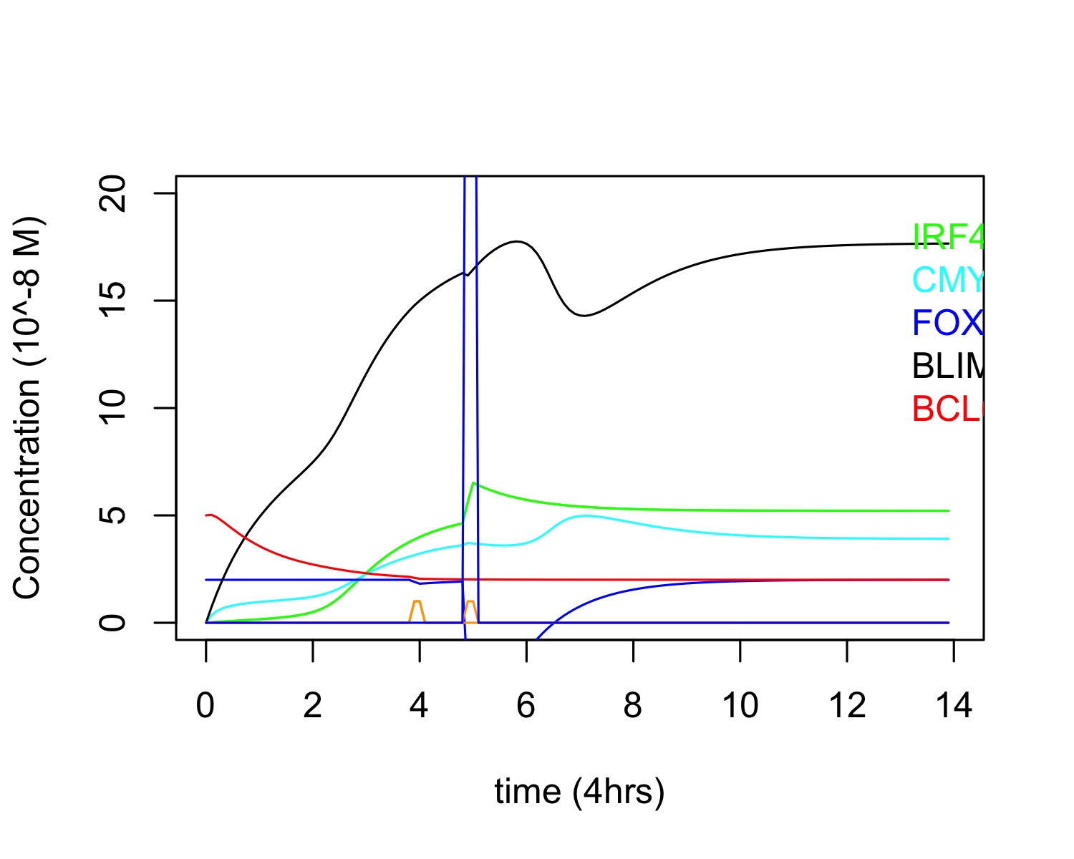
GRN of PC differentiation in GC (M8 with cMYC and Foxo)
CCs recycling calculate their divisions soon after rescue. Then they wait for 10 hrs before turning to CBs.
PC differentiation can take between 10 and 34 hours (recycling + divisions)
A=0
bcr0=1
bcr0 duration= 0.1 time steps
Cd40=50
Cd40 duration= 0.125 time steps
A=0.5
bcr0=1
bcr0 duration= 0.1 time steps
Cd40=50
Cd40 duration= 0.125 time steps
A=1
bcr0=1
bcr0 duration= 0.1 time steps
Cd40=50
Cd40 duration= 0.125 time steps

